Slide 1

“ONLINE SHOPPING”: The effective and credibility system for sellers and buyers
Submitted in partial fulfillment of the requirements for the award of the Degree of
BACHELOR OF TECHNOLOGY
In
COMPUTER SCIENCE AND ENGINEERING
Submitted by
K.JAYASRI (173N1A0526)
A.PAVITHRA (173N1A0502)
G.KULLAY REDDY (183N5A0501)
G.THARAKESHWAR (173N1A0517)
T.KESHAVA REDDY (183N1A0502)
Under the esteemed guidance of
K.RUBIYA ALAM M.Tech.,
Assistant Professor
DEPARTMENT OF COMPUTER SCIENCE AND ENGINEERING
P.V.K.K Institute of Technology
An ISO 9001-2015 Certified Institute
(Approved by AICTE, New Delhi & Affiliated to JNTUA, Anantapur.) Sanapa road, Rudrampeta, Anantapuramu-515001
Andhra Pradesh
2017-2021

Slide 2
abstract
The shopping cart project needs to create the shopping cart system to organize the products record and the other information about the customers. How customers can buy products from a website can be recognized from their username and password. Online shopping is rising day by day in India. Because India is the country where computer users are increasing day by day so the online shopping trends are also increasing.

Slide 3
CONTENTS
INTRODUCTION
EXISTING SYSTEM
DISADVANTAGES
PROPOSED SYSTEM
ADVANTAGES
SYSTEM REQUIREMENTS
MODULES
SYSTEM DESIGN
RESULT
CONCLUSION

Slide 4
INTRODUCTION
Online shopping is rising day by day in India. Because India is the country where computer user's are increasing day by day so the online shopping trends are also increasing. The shopping cart project needs to create the shopping cart system to organize the products record and the other information about the customers. How customers can buy products from a website can be recognized from their username and password.

Slide 5
EXISTING SYSTEM
In the existing system all transactions, dealings of products, purchasing of products were done manually which is time consuming. Reports are prepared manually as and when needed. Maintaining reports is a very tedious task. To buy any product user has to collect information about it either by visiting the shop or asking people which is the better one. There is no computer system for handling payments.All calculations are performed manually which may not be accurate always. Maintaining the record is really a tedious task. Any internet user can use this existing website to search for any kind of products, select particular products from a wide range of products.

Slide 6
DISADVANTAGES:
Malls and markets are so crowded that you can barely walk.
Time consuming.
Manual maintance of customer records and all transactions.

Slide 7
PROPOSED SYSTEM
The motive of this Online Shopping Web Application is to allow the user to play with the search tool. Traditional user interfaces. Provide Interactive interface through which a user can interact with different areas of application easily. This application provides an easy and convenient way to search for products specific to their needs. This would list a set of products based on the search term and the user can further filter the list based on various parameters.

Slide 8
Advantages:
This application provides an easy and convenient way to search for products specific to their needs.
Automatic maintenance of customers and their respective products details.
convenient way to search for products specific to their needs.

Slide 9
SYSTEM REQUIREMENTS
Software Requirements
OS : Windows 7
Technology : PHP, Bootstrap(HTML, CSS), JavaScript,
Jquery.
Database : MySQL
Server : XAMPP
IDE : Notepad++
Hardware Requirements
RAM : 4GB
ROM : 500GB
Processor : i3 Quad core

Slide 10
MODULES
Manage Orders
Manage Users
Manage Categories
Manage Products

Slide 11
SYSTEM DESIGN
The design of input focuses on controlling the amount of input required, controlling the errors, avoiding delay, avoiding extra steps and keeping the process simple. In any system results of processing are communicated to the users and to other system through outputs.

Slide 12
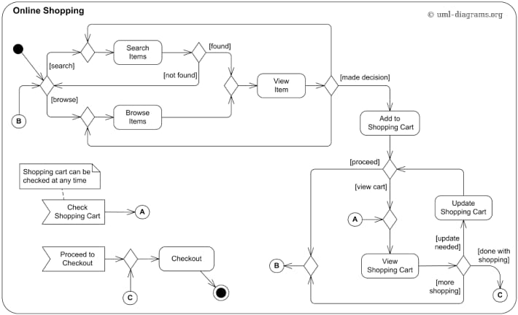
UML DIAGRAMS
ACTIVITY DIAGRAM:

Slide 13
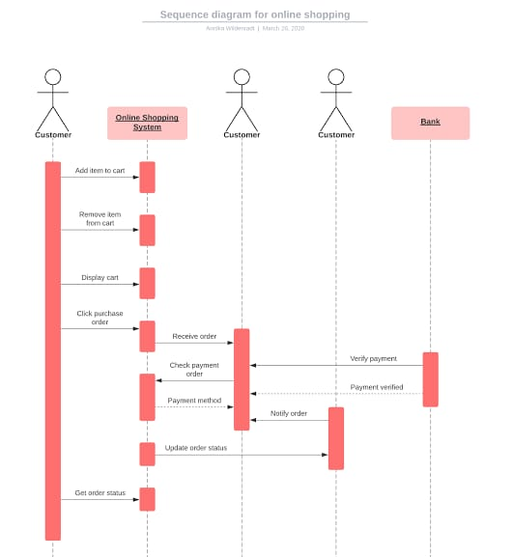
SEQUENCE DIAGRAM :

Slide 14
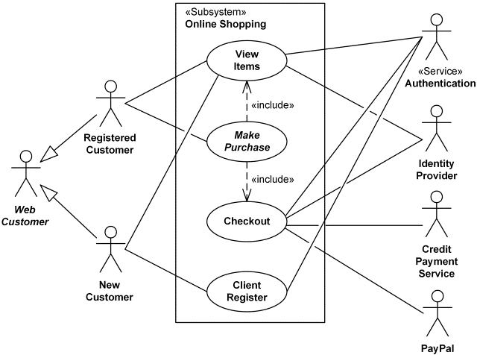
USE CASE DIAGRAM :

Slide 15
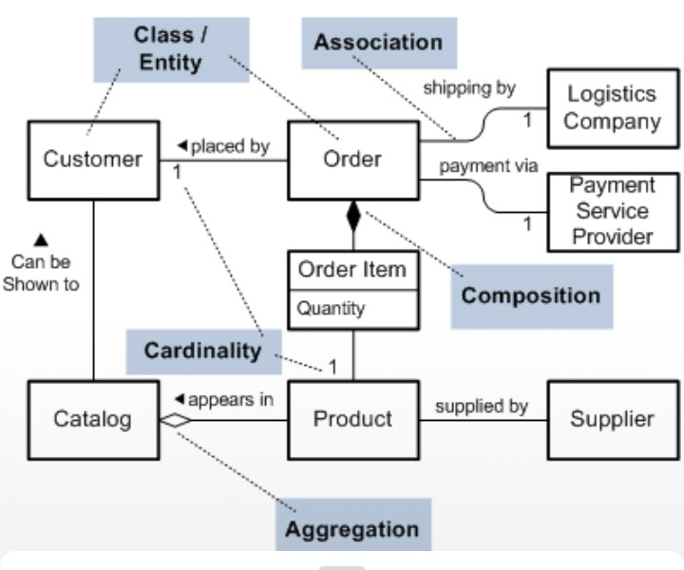
SYSTEM ARCHITECTURE

Slide 16
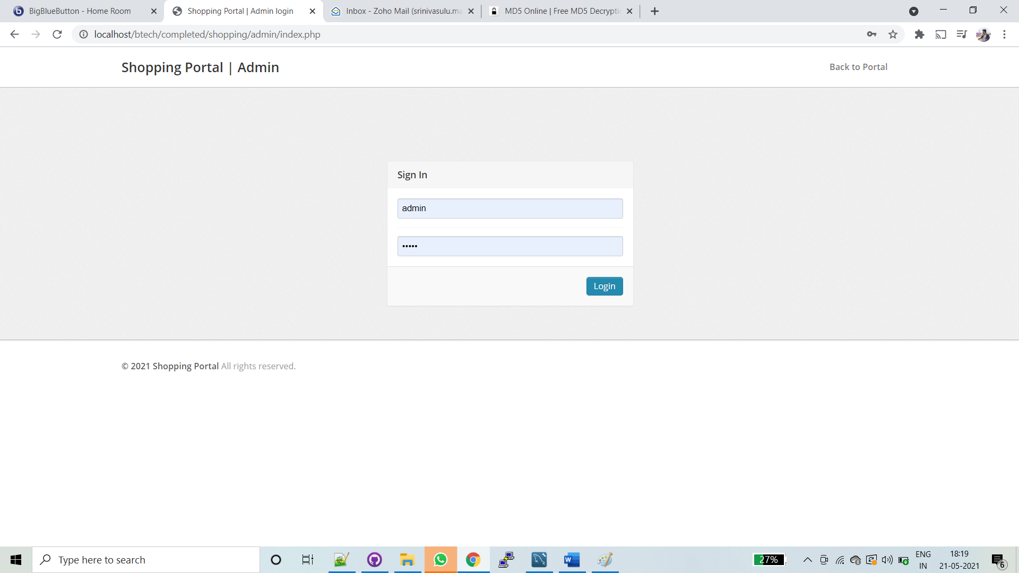
RESULT
1.ADMIN LOGIN

Slide 17
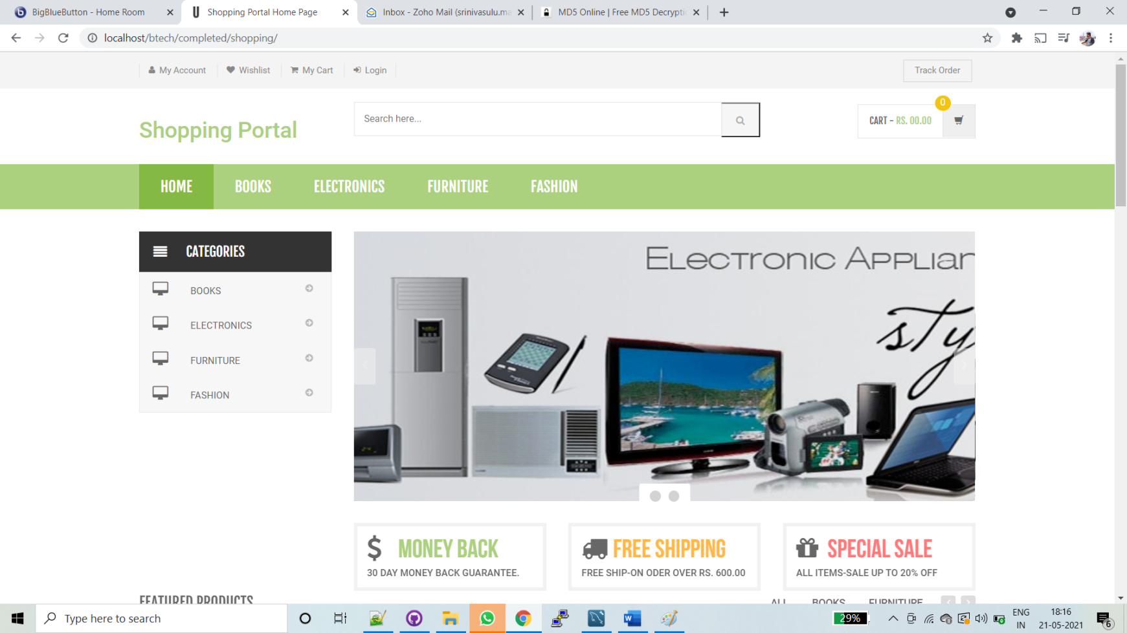
2.ADMIN HOME/MAIN PAGE

Slide 18
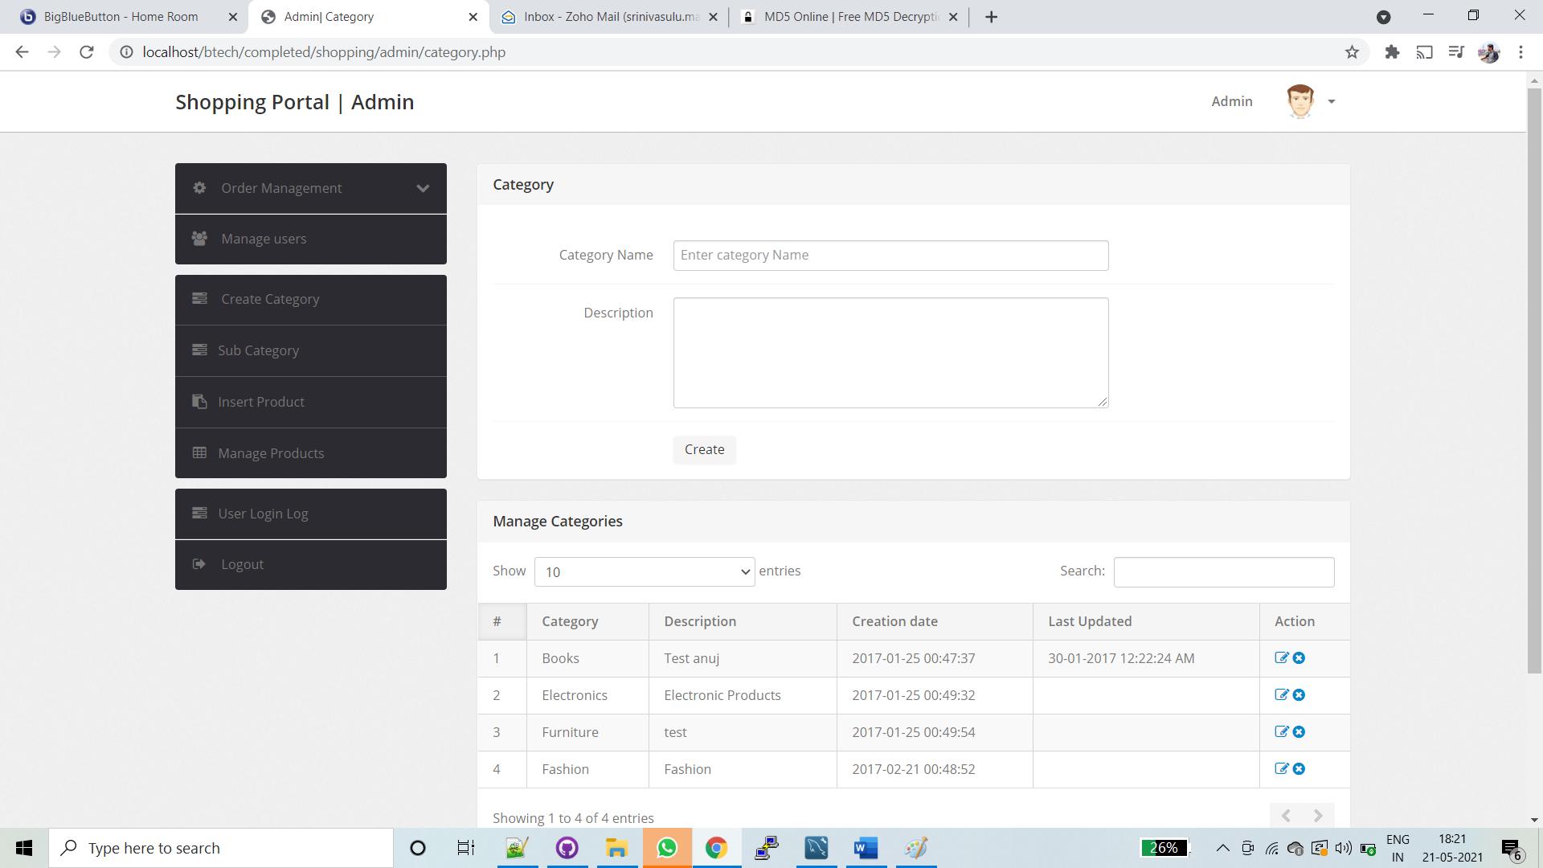
3.ADMIN – creates category under which item to be upload

Slide 19
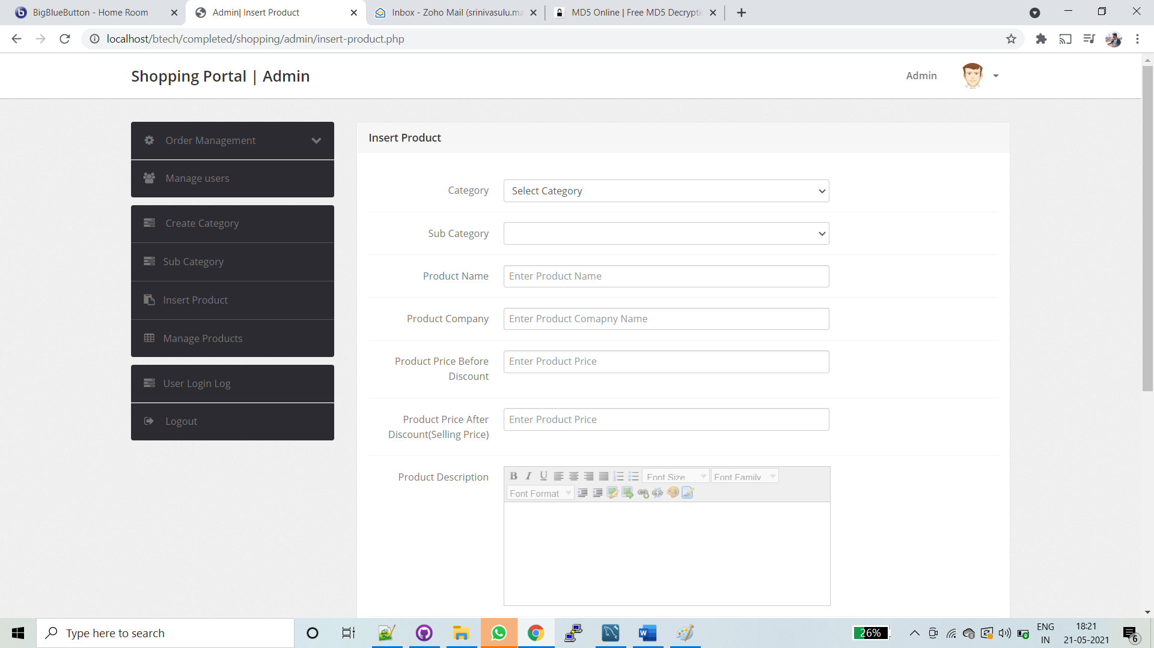
4.ADMIN ADD PRODUCT

Slide 20
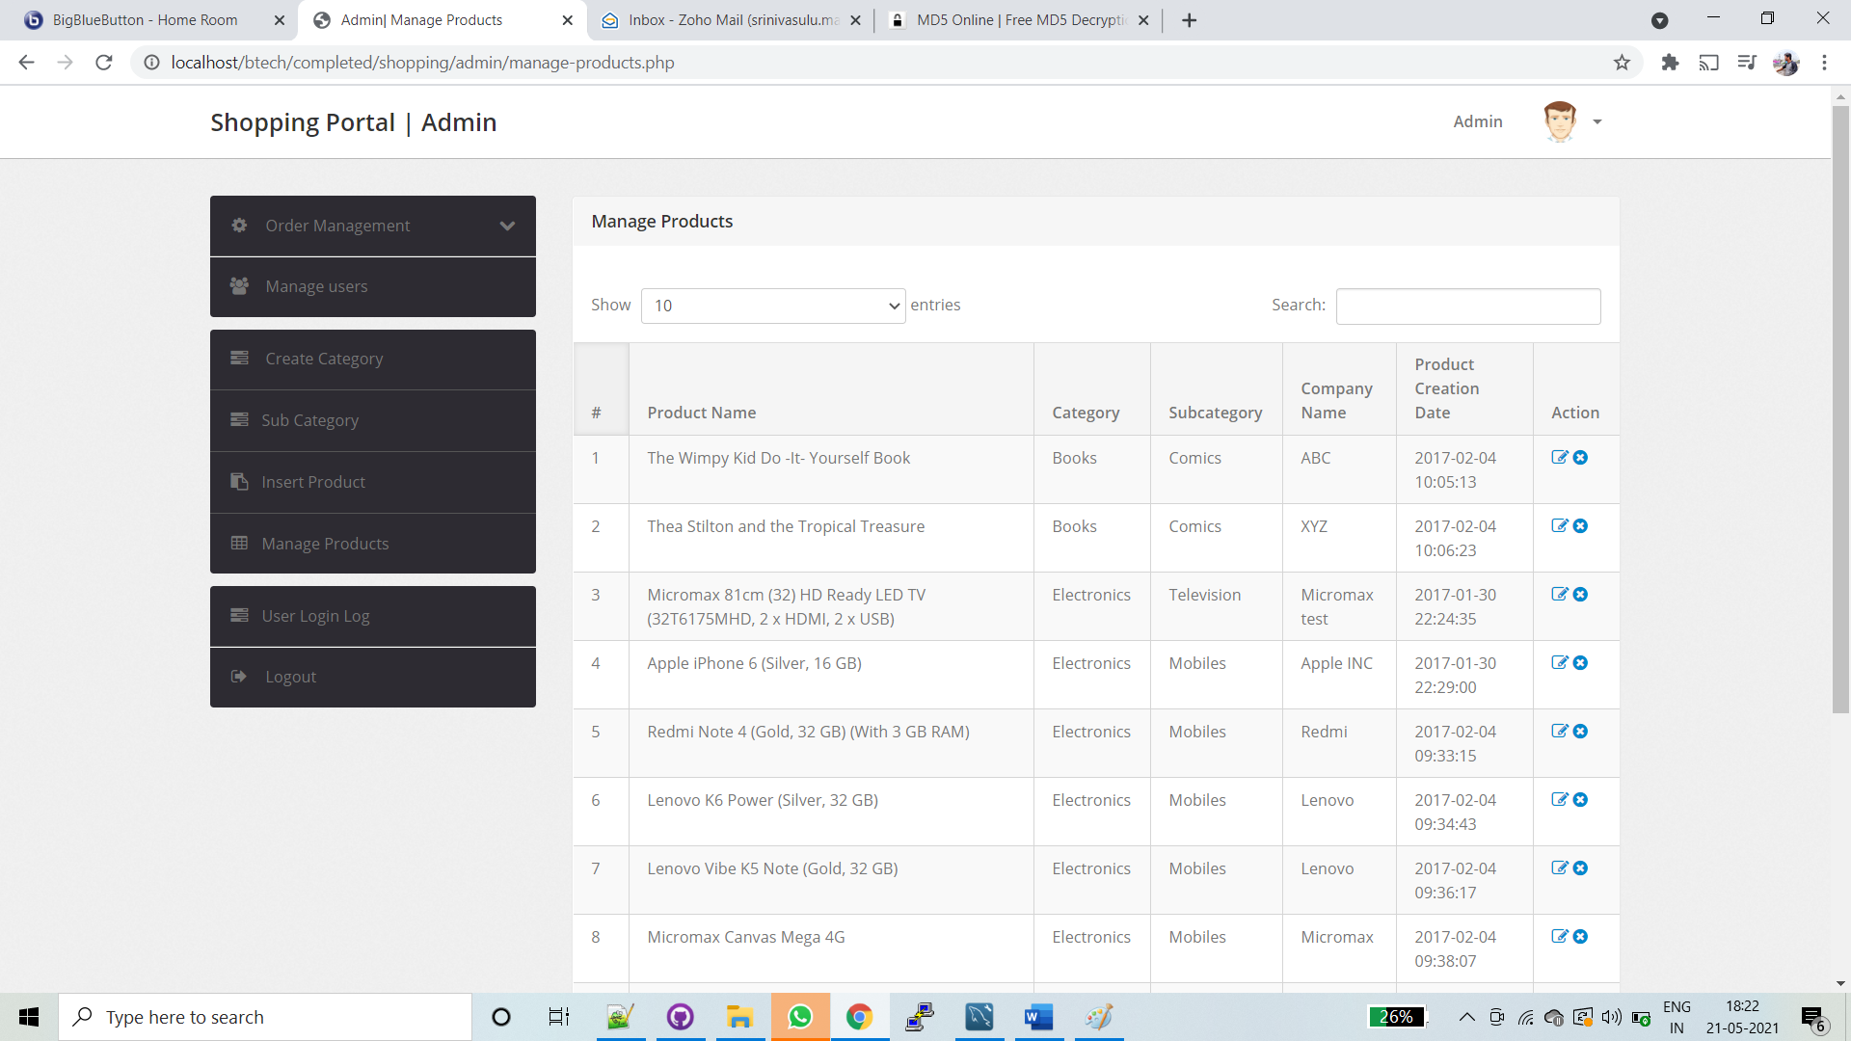
5.ADMIN – added product List

Slide 21
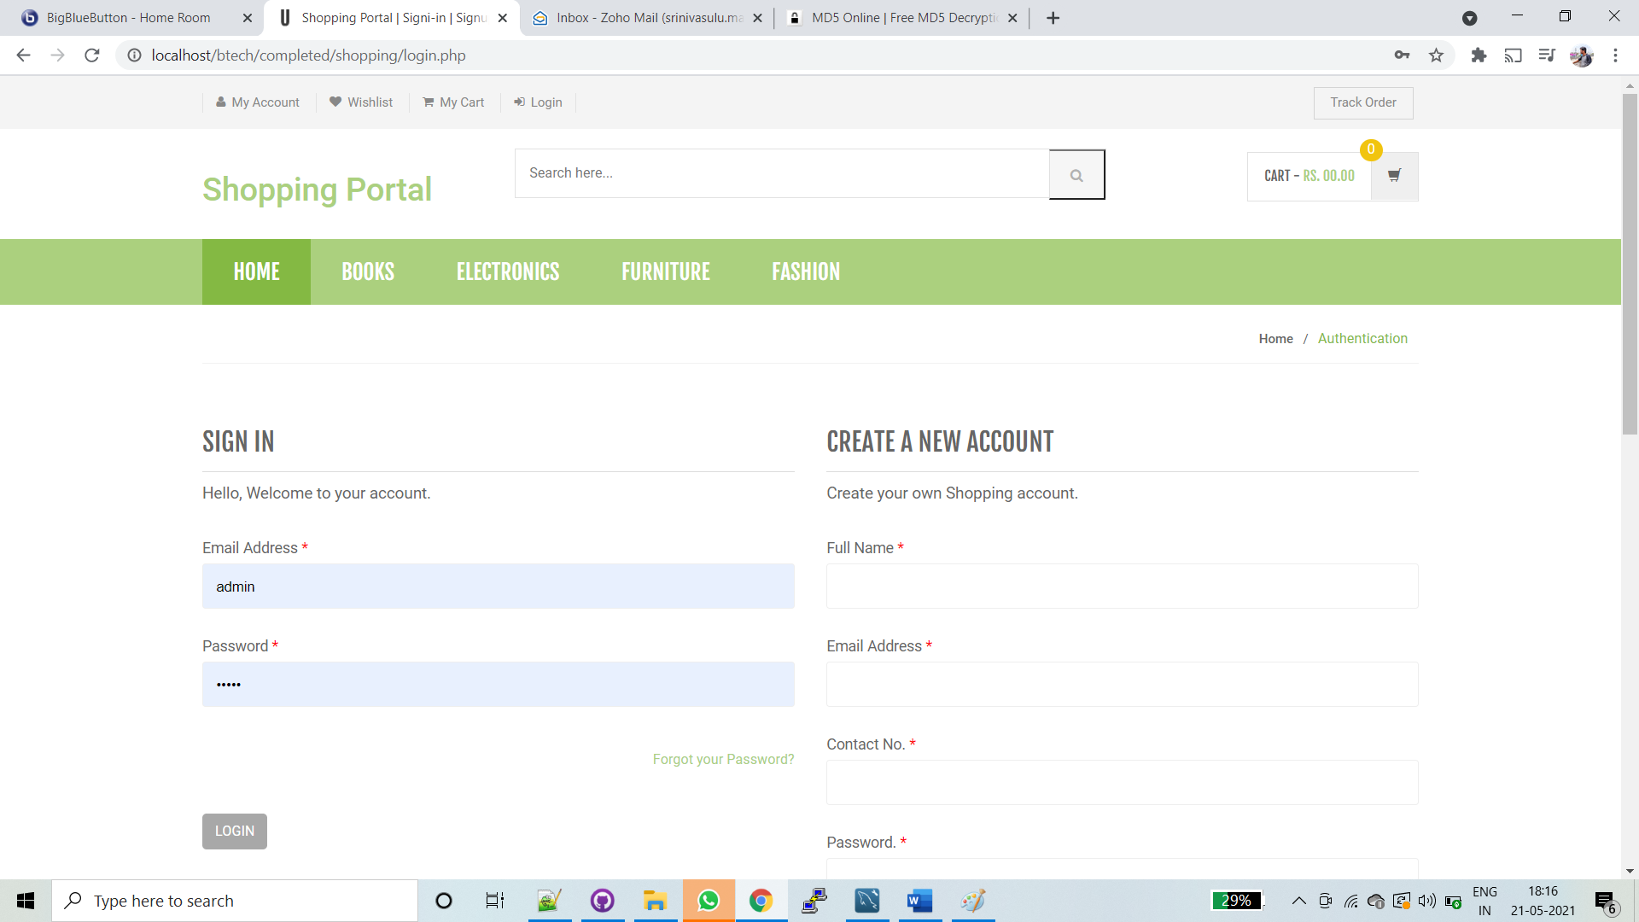
6.USER LOGIN/SIGNUP

Slide 22
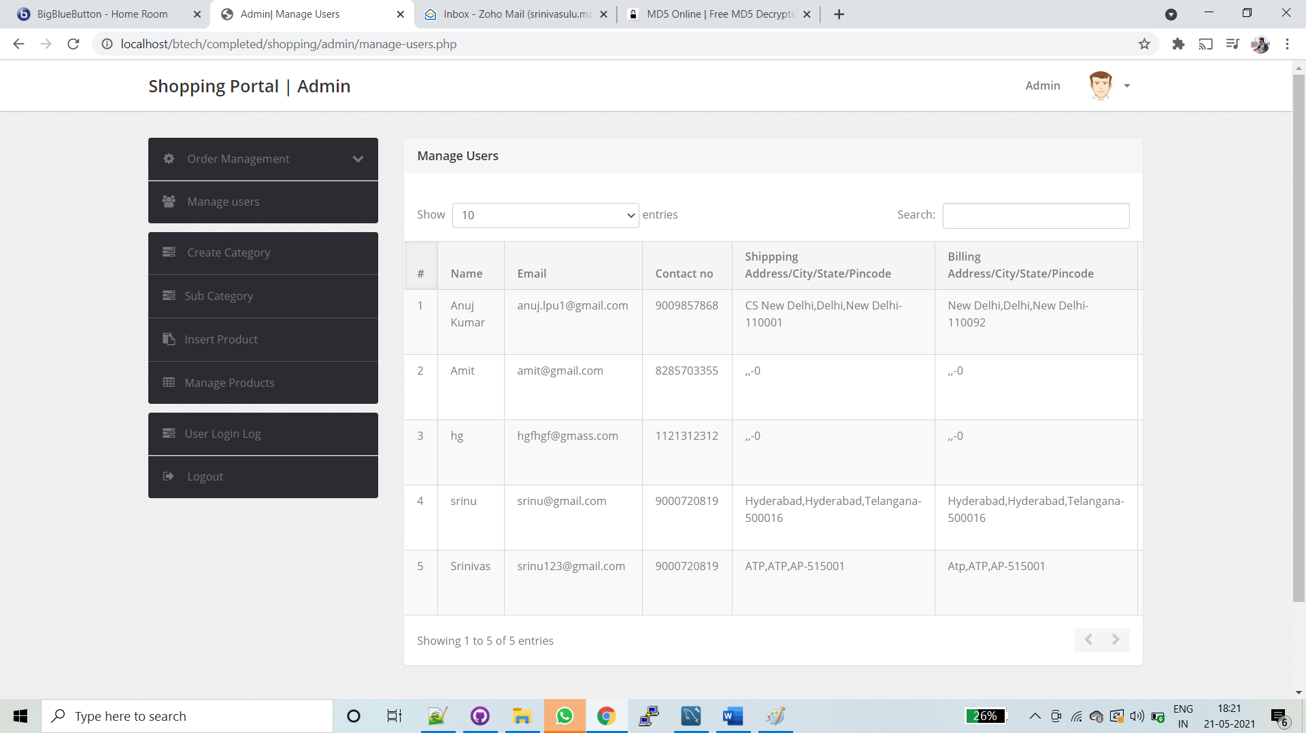
7.USER’S LOG

Slide 23
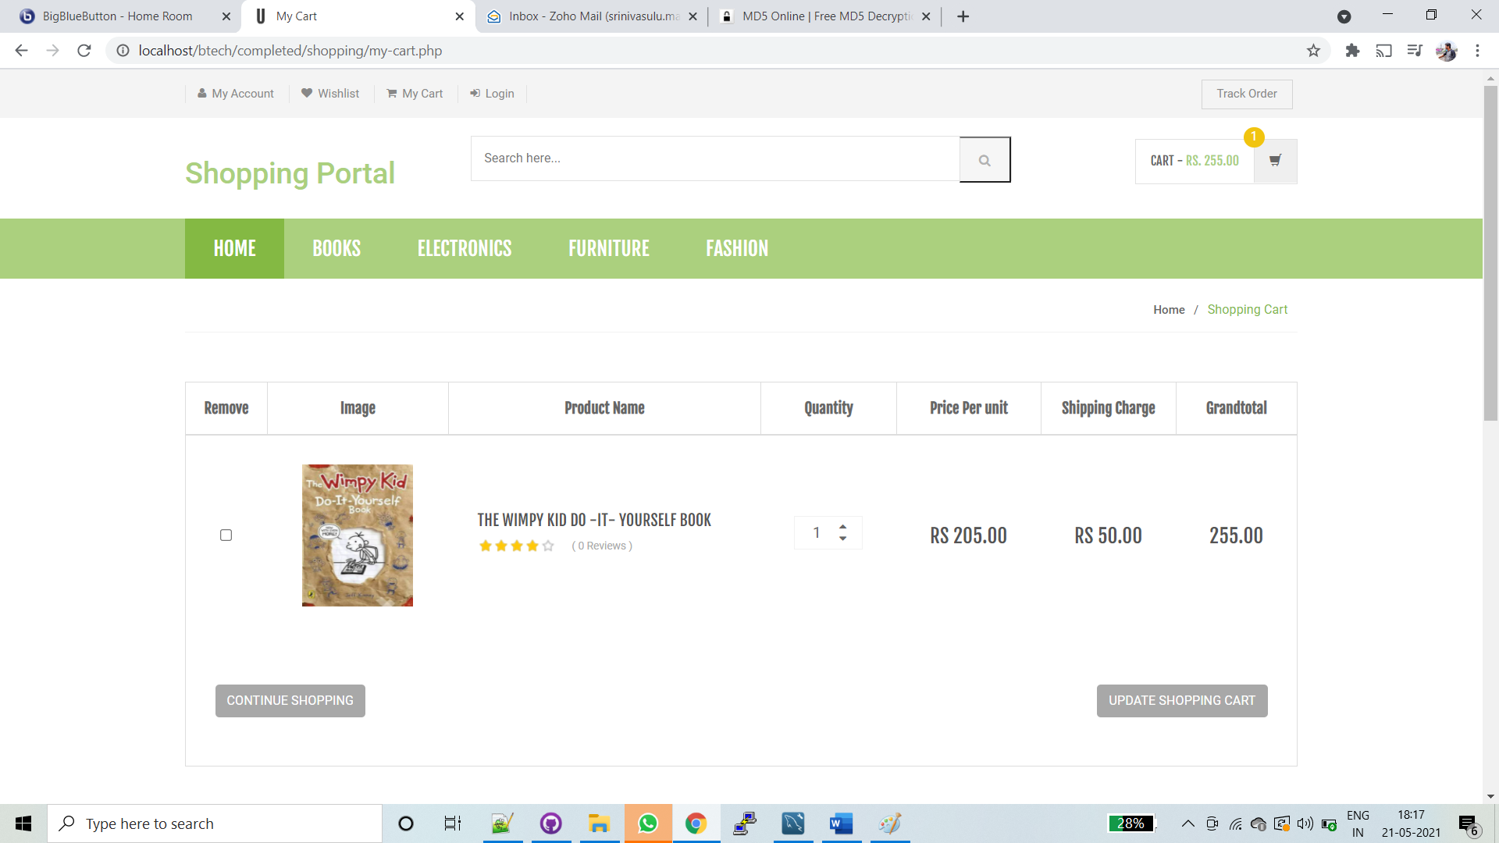
8.uSER CART

Slide 24
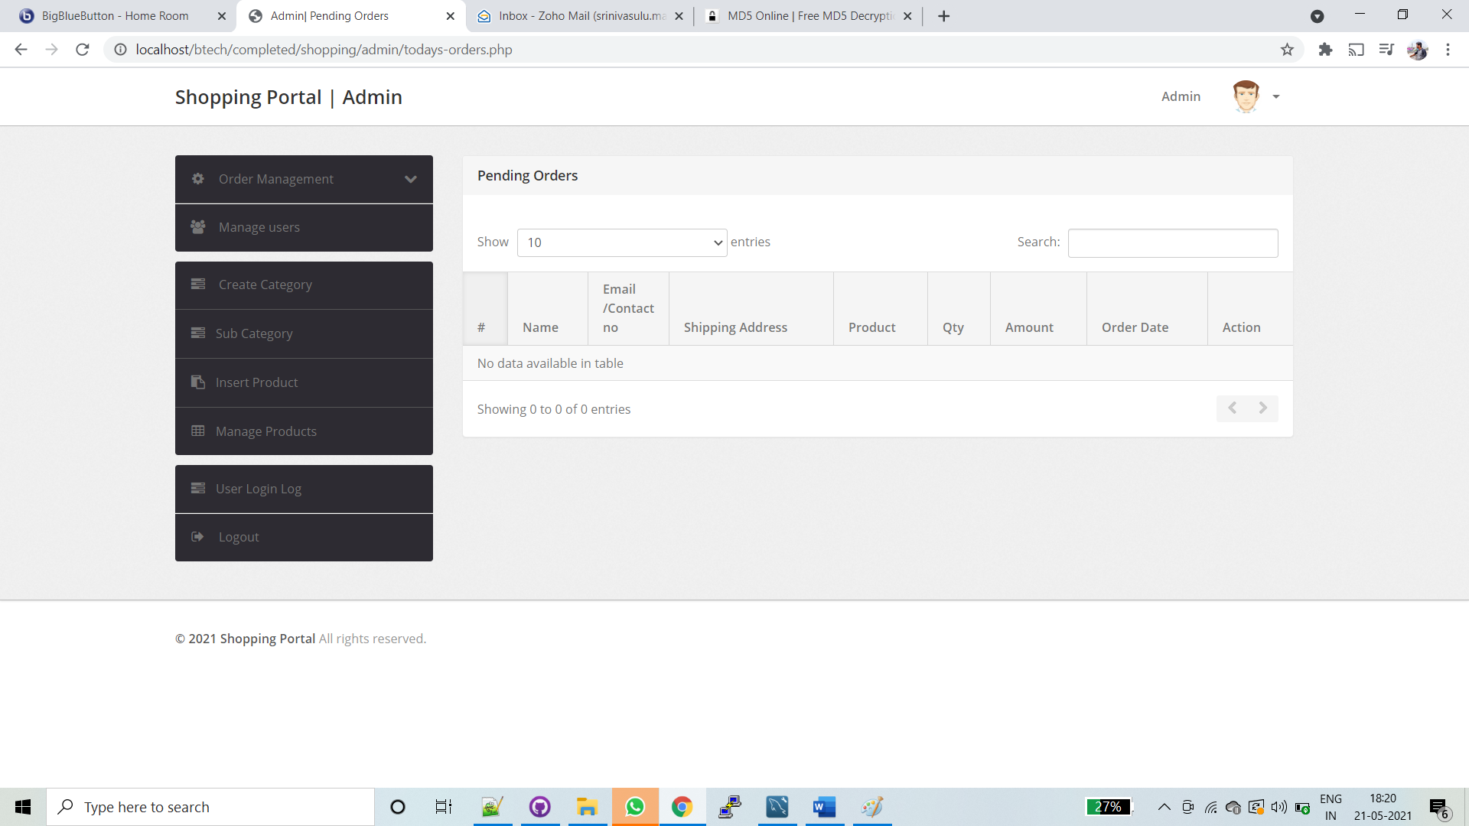
9.ORDERS RECEIVED FROM USER

Slide 25
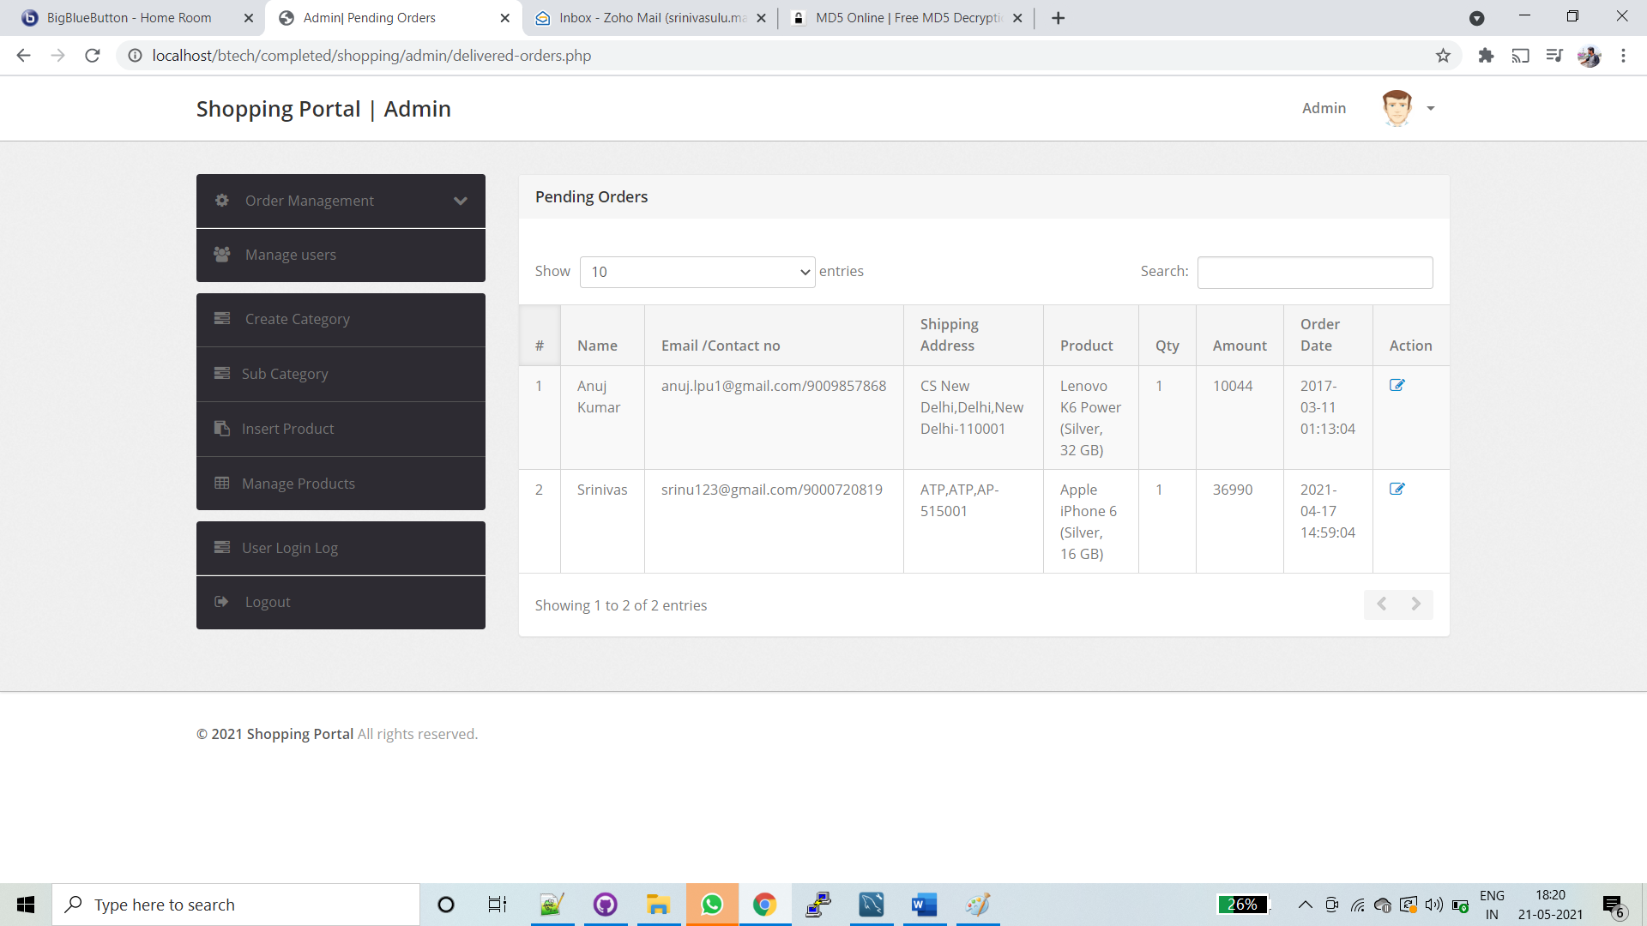
10.DELIVERED ORDERS

Slide 26
CONCLUSION
Technology has made significant progress over the years to provide consumers a better online shopping experience and will continue to do so for years to come. The project made here is just to ensure that this product could be valid in today real challenging world. Here all the facilities are made and tested. Currently the system works for limited number of administrations to work.

Slide 27
THANK YOU

